Slide 1
Java Fundamentals
03-31-2017

Slide 2
Static
Final
Object Initialization
Hash Code and Equal
Overriding Rules
Method Hiding
Immutability
Cloning
Annotations
String pool
Exception Handling
Serialization
Inner Class
AGENDA

Slide 3
Use Of Static keyword
01

Slide 4
Static Keyword
Static keyword is used to declare a member, as CLASS level member
In other words, all objects of a class share the same copy of STATIC members
A class can have following types of static members:
Static Variables
Static methods
Static blocks of code
Static Inner Class (Captured in Separate PPT for inner classes)
Interface Static Method (Java 8 onwards)

Slide 5
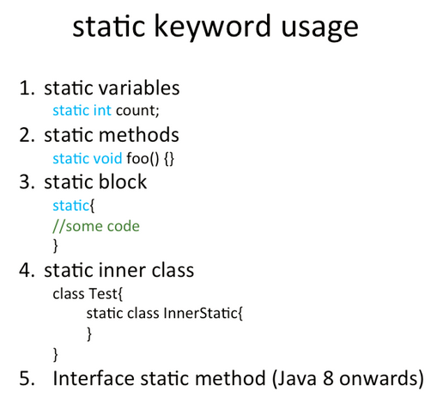

Slide 6
Static Variables (Class Variables)
These are initialized when the class is loaded.
Static variables are shared (All objects of the same class share the value of static variable)
Static variables (1 per class) – unlike Instance Variables (1 per instance)
Static variables are initialized before the object of the class can be created

Slide 7
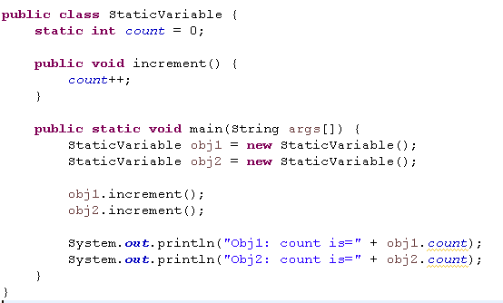

Static Variables - Example
Output

Slide 8
Static Methods (Behavior)
These are accessed directly without instantiating the object of the class.
Few methods can be made static because
They don’t use any instance variables.
Their behavior just depend upon the input parameter passed.
For ex. Min and abs methods in Math class.
Static methods can’t use non-static instance variables or methods.
Syntax <class-name>.<method-name>
public class Elephant extends Animal {
private static int count;
public Elephant() {
count++;
}
public static getCount() {
return count;
}
}
..
int count = Elephant.getCount();

Slide 9
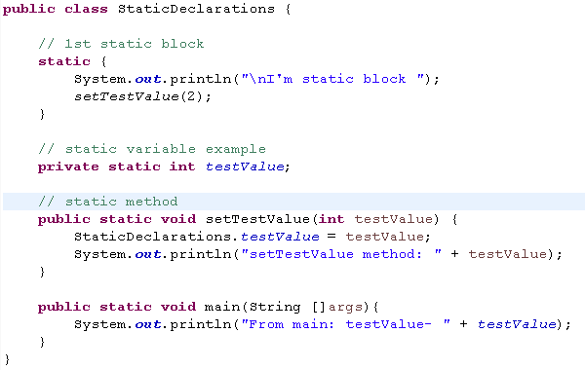

Static Block
Block of code that will be executed before anything when a class is first loaded into JVM.
Output:

Slide 10
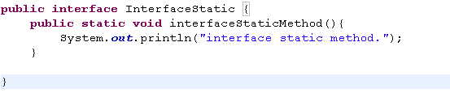
Interface static methods (Java 8 onwards)
Java interfaces can have static methods (prior to java 8)
Interface static methods can’t be overridden
Like interface default methods, the body of static interface method must be provided with in the interface only while method’s declaration.
Java interface static methods are good for providing utility methods.
Example:

Slide 11
Use of Final Keyword
02

Slide 12
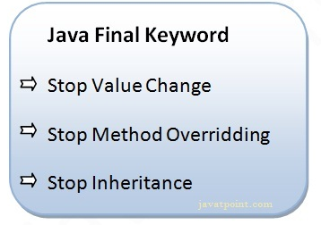
The final keyword in java is used to restrict the user. The java final keyword can be used in many context.
Final with:
Variable –Can’t change the value
Private final int count;
Private final Object obj;
Method- can’t override the method
Public final setStatue(){
// method definition
}
Class- Can’t extend the class
Public final class Singleton{
// Class definition
}

Slide 13
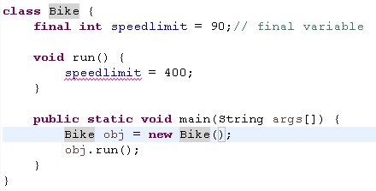
Final Variable
If you make any variable as final, you cannot change the value of final variable.
It will be constant.
Execution will end up in Compilation error.
As we are trying to change the value of final variable.

Slide 14
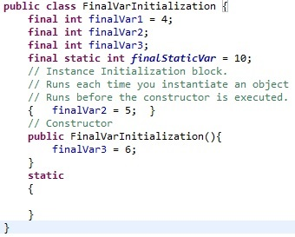
Final Variable Initialization
Final variable can be initialized only at 3 places-
At the time of variable declaration.
Inside the constructor.
Inside Instance Initialization block
See how finalVar3 is initialized in constructor
finalVar2 is initialized in instance initializing block.
finalVar1 is initialized at the time of declaration.
Try not to initialize finalStaticVar4 at the time of declaration (put it in constructor) and it will give compiler error.
Note: Static Final variables must be assigned at the time of declaration. Else it will give you compile time error.

Slide 15
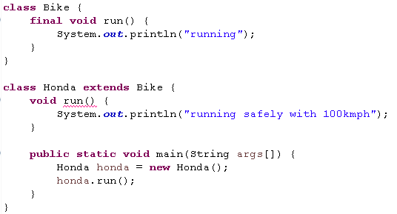
Final Methods
If you make any method as final, you cannot override it.
Execution will end up in Compilation error (as we are trying to override final method run()).

Slide 16
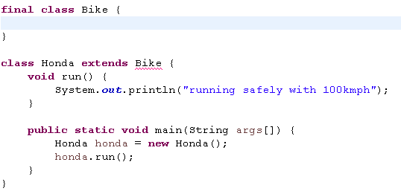
Final Class
If you make any class as final, you cannot extend it.
Execution will end up in Compilation error (as we are trying to override final class– Bike)

Slide 17
Final Class Usage
Why to make a class final ?
One reason can be security, when you want to prevent inheritance of a class.
Another can be optimization.
Final classes are used when you are writing immutable classes which are highly used in multi-threaded environment.
Some classes perform standard functions and they are not meant to be modified
Note: String class in java is final class (provides Security, Optimization etc)

Slide 18
Q/A
Q: Is final method inherited?
A: - Yes, final method is inherited but you cannot override it.
Q: Can we initialize blank final variable?
A: Yes, but only in constructor.
Q: Can we declare a constructor final?
A: No, because constructor is never inherited.
Q: Final parameter, what is it?
A: If you declare any parameter as final, you cannot change the value of it.

Slide 19
Object Initialization
03

Slide 20
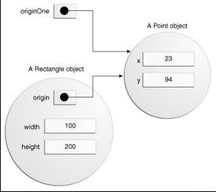
Object Initialization
An object is a chunk of memory, bundled with the code-that-manipulates-memory.
Object initialization in java is done through constructors.
Keyword – new is used to create new object.
You can allocate memory for a new object with the new operator or the newInstance() method of class “Class”.
Java objects resides in Heap and there references are stored in reference variables.

Slide 21
Default Initial Values
Type | Default Value
boolean | False
byte | 0
short | 0
int | 0
long | 0L
char | \u0000
float | 0.0F
double | 0.0d
object reference | null
If you provide no explicit initialization to instance variables, they will be awarded predictable default initial values.
Table shows default initial values for each variable.
Local variables are not given default initial values, they must be initialized explicitly before they are used.

Slide 22
Constructor
Object Creation
Elephant elephant = new Elephant();
Constructors are used to set the values in instance variables or process anything required before an object can be used.
The constructor name need to be same as class name.
Constructor does not return anything.
A class can have multiple overloaded constructors.
public class Elephant {
int size;
// Default constructor
public Elephant() {
size = 100;
}
// Pass parameter to set constructor
public Elephant (int size) {
this.size = size;
}
}

Slide 23
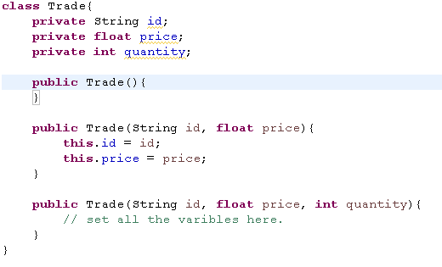
Types of Java Constructor
Default constructor (no-arg constructor)
Default constructor provides the default values to the object like 0, null etc. depending on the type.
Parameterized constructor
Parameterized constructor is used to provide different values to the distinct objects.
Constructor Overloading in Java
A class can have any number of constructors that differ in parameter lists. Depending on the parameter list specified, right constructor is called.

Slide 24

Example - Writing Address Class
Write a Address class and print the address on output console.
Demonstrate “AddressTest” example.
Understand the following -
Class and Object.
How to instantiate a class.
Test class.
Instance Variables and Methods.
Creating and using a constructor.

Slide 25

Example - Writing Employee Class
Write an Employee class and print its emp id, name, project and address details.
Demonstrate “EmployeeTest” example.
Understand the following
How a class is called from other class.

Slide 26
Initialization and Inheritance
To initialize and object fully, all instance variable declared in its class and in its super classes must be initialized.
Super() is the way to call base class constructor from child class constructor.
This() is the way to call this class constructor.
When an object is initialized, it’s base class constructor will be called first.
We can specify the default or parameterized super() call from this constructor.
If we don’t specify super (default or parameterized) call from this constructor, then default super() is called automatically.

Slide 27
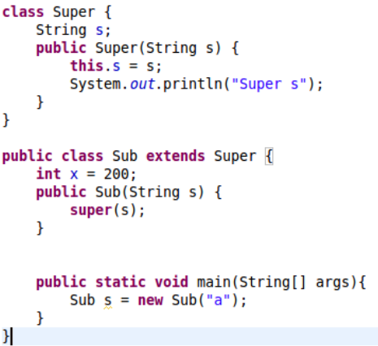

Slide 28
Hash Code and Equal Contract
04

Slide 29
The methods hashCode() and equals() play a distinct role in the objects you insert into Java collections.
Both equal() and hashcode() methods are present in java.lang.Object class.
Signature:
public boolean equals(Object obj);
public int hashCode();
hashcode() method:
Used when you insert an object into collections like – HashTable, HashMap or HashSet
equal() method:
Used to check if two objects are equal or not.
Used in most collections to determine if the collection contains the given element.

Slide 30
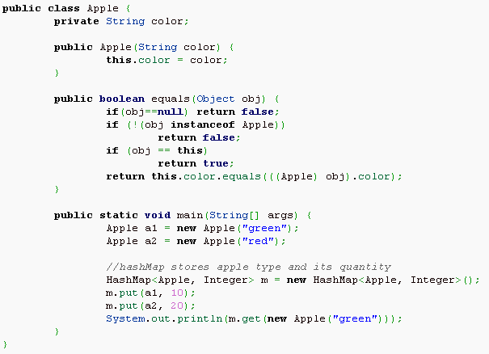
Equal() and hashCode() Contract
If two objects have the same hash code, they may or may not be equal.
But, If they are equal, then they must have same hash code.
Note: contract above also works as a guiding rule for overriding the contract
Here in Apple class, we are overriding the equal method but not the hashcode.
Output shows “null” as both objects has different hashcode though they are equal.

Slide 31
Overriding Rules
05

Slide 32
Overriding Rules
The argument list must exactly match that of the overridden method.
The return type must be the same as, or a subtype of, the return type declared in the original overridden method in the superclass.
The access level can't be more restrictive than the overridden method's.
Ex.- public to protected is not allowed.
The access level CAN be less restrictive than that of the overridden method.
The overriding method CAN throw any unchecked (runtime) exception, regardless of whether the overridden method declares the exception.
The overriding method must NOT throw checked exceptions that are new or broader than those declared by the overridden method.
The overriding method can throw narrower or fewer exceptions.
Instance methods can be overridden only if they are inherited by the subclass. Methods from super class that are not marked private or final.
You cannot override a method marked final and static.

Slide 33
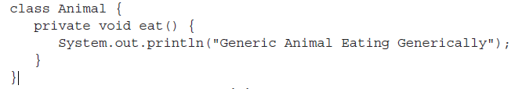
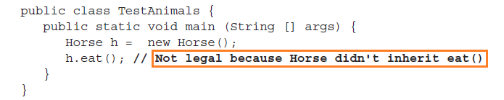

Examples : Legal and Illegal Method Overrides

Slide 34

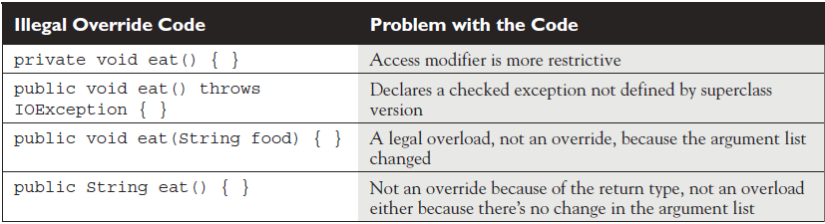
Examples of Illegal Overrides
Look at below example code
Table shows the illegal overrides and problems with code

Slide 35
Method Hiding
06

Slide 36
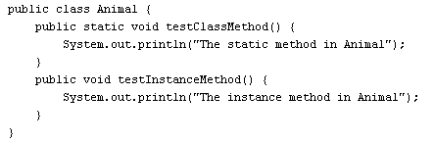
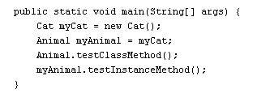
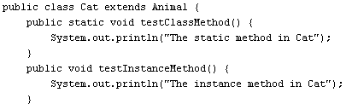

Method Hiding
Subclass defines a static method with the same signature as a static method in the superclass.
The version of the hidden static method that gets invoked depends on whether it is invoked from the superclass or the subclass reference variable.
Animal and Cat class-

Slide 37
Immutability
07

Slide 38

Immutability
An immutable class is simple a class whose instances cannot be modified.
Immutable classes are easier to design and implement, less prone to error and more secure.
Immutable objects are inherently thread safe and do not require synchronization.
They can be reused by providing static factories that cache frequently requested instances to avoid creating new instances.
String class in java is Immutable!

Slide 39
Rule For Immutable Class
Ensure class can’t be extended ( final class)
Make all fields final.
Make all fields private
Don’t provide any method that modify the object’s state i.e. don’t provide setters methods.
Ensure exclusive access to any mutable components.
If class has any field that refer to a mutable objects, ensure that clients of that class can not obtain references to these objects.
If instance variable are mutable, return a new object with copied content from there getter methods.

Slide 40
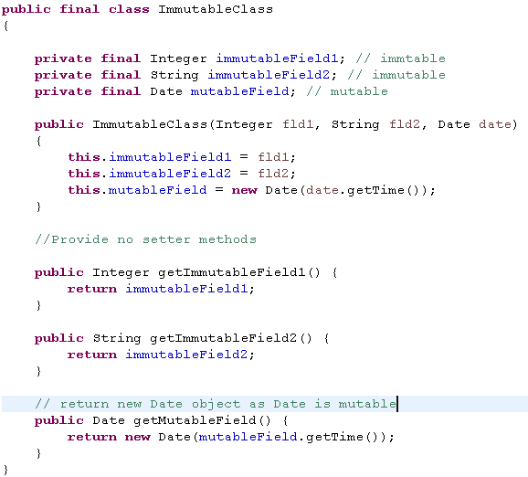
Example

Slide 41
Java Cloning
08

Slide 42

Cloning Introduction
Cloning is a java concept through which we can create a duplicate object at run time.
In contrast of creating a new object of the same type and setting its property explicitly, cloning create a bit by bit copy of the object at run time.
We can not clone any java object. We can clone an object if its class is cloneable (implements java.lang.Cloneable).
Object class has clone() method that is used to create a clone of an object.

Slide 43
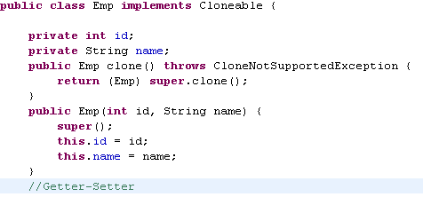
Cloning Example

Slide 44
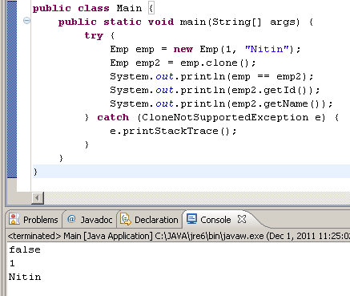
Cloning Example Client

Slide 45
Shell-O-Copy
Default implementation of clone method in Object class copy references of contained objects (We do not have a separate copy of the contained object).
In the below figure, If a change is made in the department head of dept1, those changes will also be reflected to the dept2.
Department
int id = 5
String name = “IT”
Emp departmentHead
Department
int id = 5
String name = “IT”
Emp departmentHead
dept1
dept1
Emp
int id = 5
String name = “Nitin”
Emp
int id = 5
String name = “Nitin”
Clone
Department
int id = 5
String name = “IT”
Emp departmentHead
Department
int id = 5
String name = “IT”
Emp departmentHead
dept2
dept2

Slide 46
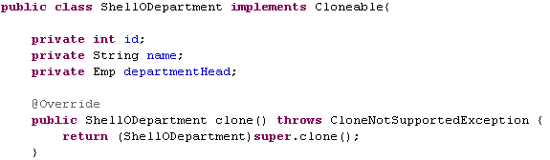
Shell-O-Copy Example

Slide 47
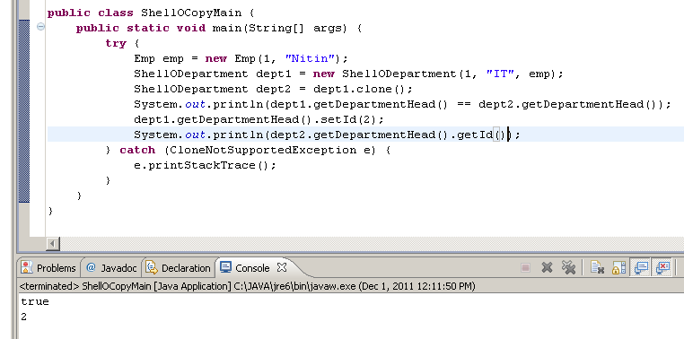
Shell-O-Copy Example Client

Slide 48
Deep-O-Copy
If we clone an object through deep-o-copy, contained object also should be cloned.
In the below figure, If a change is made in the department head of dept1, those changes will not be reflected to the dept2.
Department
int id = 5
String name = “IT”
Emp departmentHead
dept1
Emp
int id = 5
String name = “Nitin”
Clone
Department
int id = 5
String name = “IT”
Emp departmentHead
Emp
int id = 5
String name = “Nitin”
dept2

Slide 49
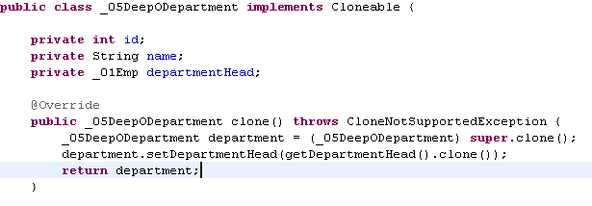
Deep-O-Copy Example

Slide 50
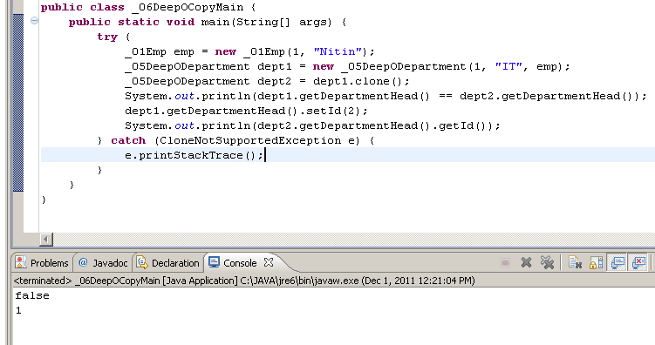
Deep-O-Copy Example Client

Slide 51

Exercise
Write a Deep-O-Copy Cloneable Fruit Basket class having list of Fruits.

Slide 52
Java Annotations
09

Slide 53
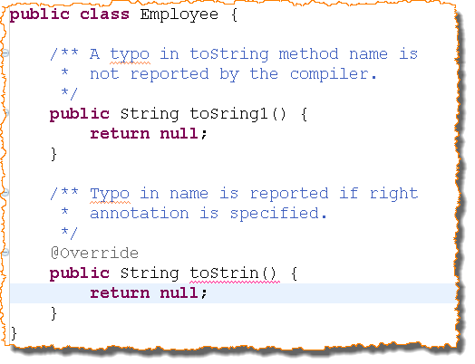
Introduction
Metadata – Information about information.
Javadocs provides information about the code but there is no consistency.
Annotations are like meta-tags that can be applied the code like constructors, methods, variables, fields etc.
Declarative style of programming.
An annotation indicates that the declared element should be processed in some special way by a compiler, development tool, deployment tool or during runtime.

Slide 54
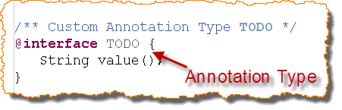
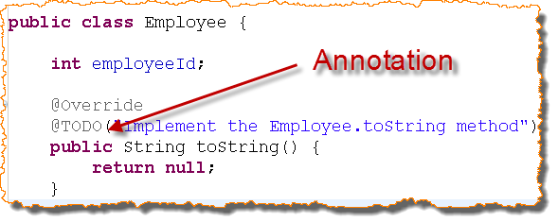
Annotation Type and Annotation
Difference between Annotation Type and Annotation.
Annotation Types can store the values in its members.
The values are passed from the place where annotation is defined.

Slide 55
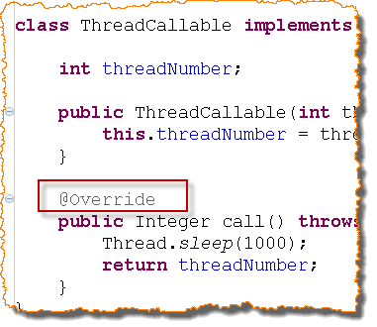
Types Of Annotation
Annotation Types
Marker Annotation
Single Member Annotation
Normal/Full Annotation
Marker Annotation
An annotation with no element.
Parenthesis can be removed.

Slide 56
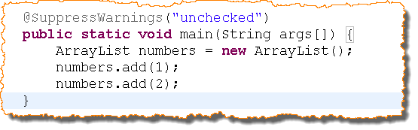
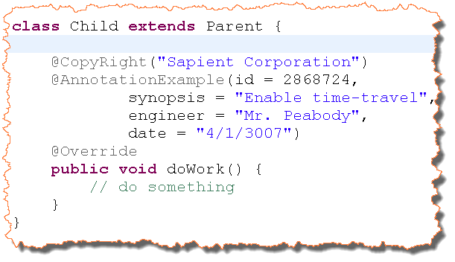
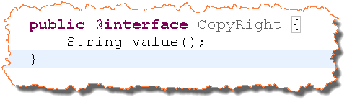
Types Of Annotation (Contd..)
Single Member Annotation
Annotation with single element.
Name of the element is value.
It is permissible to omit the name of the element and = sign.

Slide 57
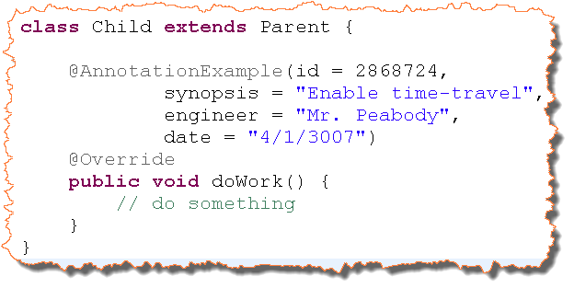
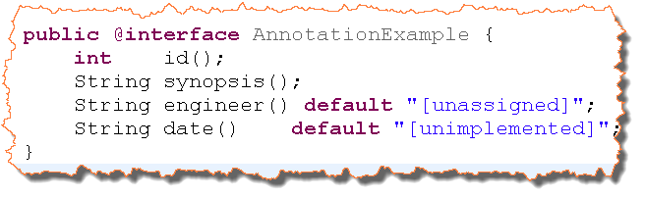
Types Of Annotation (Contd..)
Normal/Full Annotations
Have more than one elements.
Elements can have default values.
Values are assigned using name value pair and name value pairs are separated by comma.

Slide 58

Exercise
Create a Worker class with the following instance variables:
workerId : Integer
workerName : String
Override the following method:
toString
Use the @Override annotation in the above two methods. Try to change the method name and see if you get compilation error.
Implement is as WorkerTest.java

Slide 59

Build-in Annotations
Self Study
Java 5 comes with several pre built annotations
Override
Deprecated
SupressWarning
Retention
Target
They help in detecting compile time errors and creating user defined annotations.

Slide 60
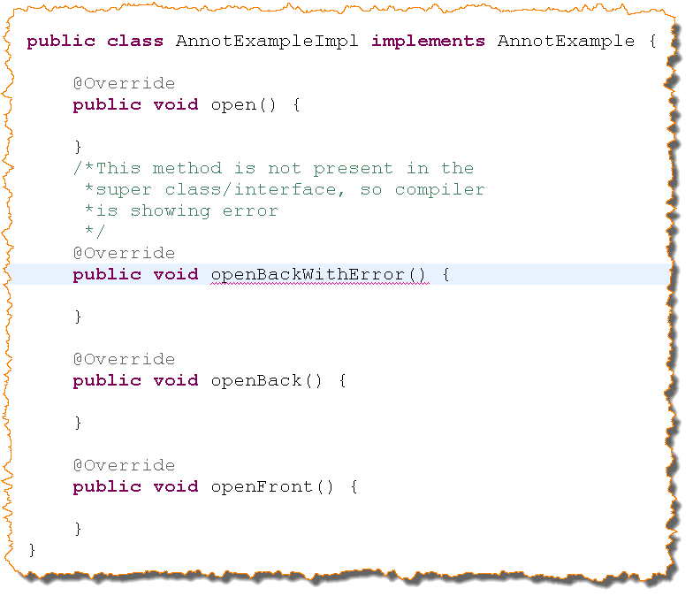
@Override
Indicates that a method declaration is intended to override a method declaration
Displays compile time error if method is not present in the parent
Target - Method
Retention - Source. This annotation is not present in .class file

Slide 61
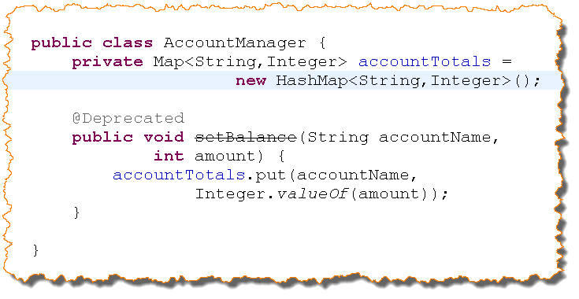
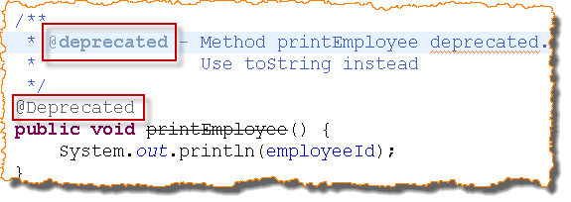
@Deprecated
Discourages the use of a program elements as they are erroneous or a better option exists.
Compiler warns the use of deprecated program elements.
Retention – RunTime.
@deprecated vs. @Deprecated – Documentation vs. Compilation

Slide 62
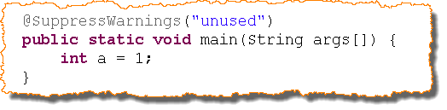
@Suppress Warning
Java generates different warnings at compile time:
Variable Unused
boxing
fallthrough
cast
Indicates that the warning type passed as value should be suppressed.
Retention – Source
Target – Field, Method, Parameter, Constructor, Type and LocalVariables

Slide 63

Exercise
Create an Employee class with the following instance variables:
empId : Integer
empName : String
Implement the following method:
printEmployee
Use the @Deprecated annotations in the above method.

Slide 64

Custom (User-Defined) Annotations

Slide 65
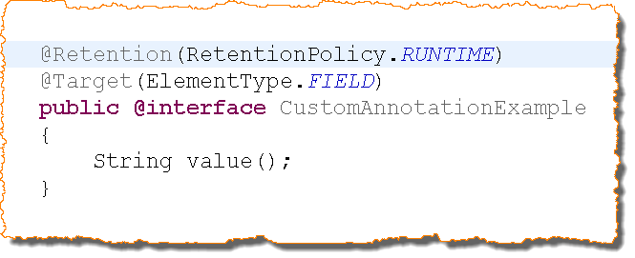
User-Defined Annotations
@interface keyword is used to define a user defined annotation.
@Retention annotation is used to define the retention policy of the custom annotation.
Source – Discarded by compiler
Class – Stored in class file but ignored by VM
Runtime – Stored in class file and read by VM
@Target annotation defines the set of elements to which this annotation applies. For exemple types, Methods, Constructors etc
@Retention and @Target annotations are not mandatory. If not provided their default value will be picked up.

Slide 66
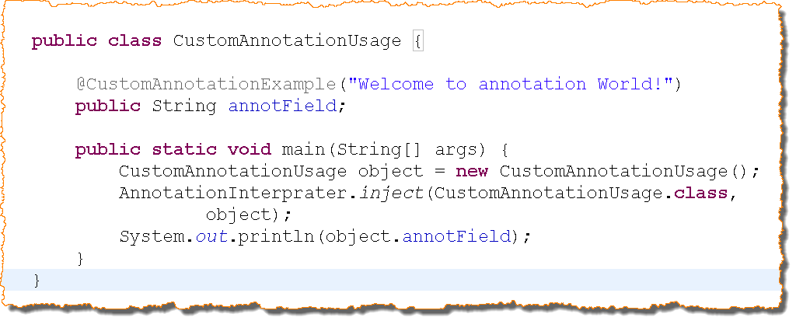
User-Defined Annotation (Contd..)

Slide 67
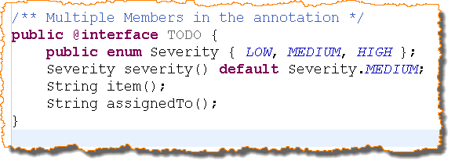
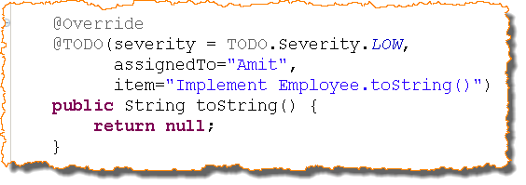
Example

Slide 68
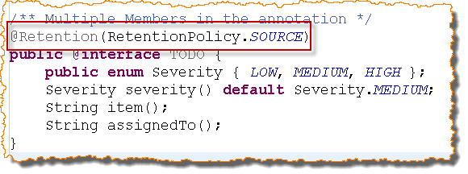
@Retention
Standard Annotation but used to annotate the custom annotation.
Indicates the retention policy of the annotation.
Takes a single value of the enumerated type Retention Policy. They are
SOURCE - discarded by the compiler
CLASS - retained by compiler and discarded by JVM
RUNTIME - Retained by both compiler and JVM
Default value is CLASS

Slide 69
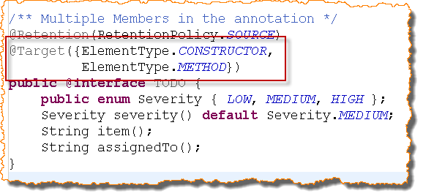
@Target
Indicates the type of program element to which this annotation will be applied
Takes a single value of the type ElementType
Values can be one of the types from ElementType
TYPE
FIELD
METHOD
PARAMETER
CONSTRUCOTR
LOCAL_VARIABLE
PACKAGE

Slide 70

Exercise 12
Create an annotation with following elements
Author name-String
Email Id-String
Employee Type-String , Default value is “permanent”
The retention policy of the annotation is CLASS and Target is class and method.
Implement is as AuthorAnnotation.java and use it in the Employee class.

Slide 71
Benefits of Custom Annotations
If your application has programming logic metadata, annotations can replace XML metadata configuration.
By moving some java comments to the class level java annotation, you can fetch the information after compilation.
Annotation properties are checked by the java compiler. You can not set an integer value in a String property.

Slide 72
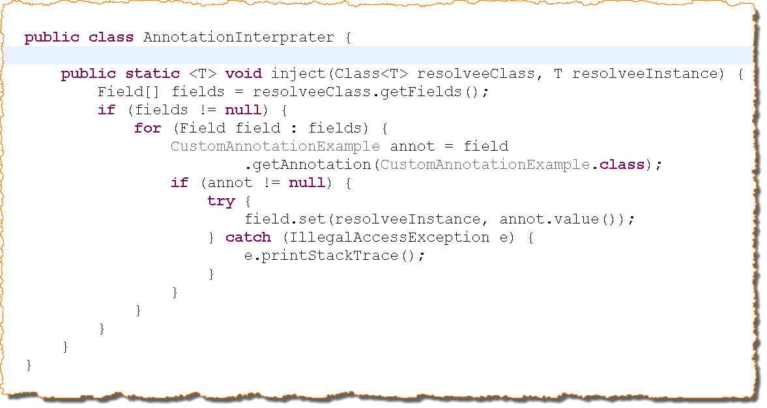
Processing Custom annotations

Slide 73

Quiz
Annotation adds _____ about the program elements
Metadata
CLASS retention policy holds the annotation in JVM memory. True/False
False
Annotation can be applied to static block. True/False
False
@_____ is used to check whether a subclass method is overriding a super class method
Override
@_____ is used to decide the retention policy.
RetentionPolicy
@_____ is used to decide the target element of the annotation
Target
@______ keyword is used to create the custom annotation
Interface
Marker annotation has ________element.
No

Slide 74
String Pool
10

Slide 75
String Pool
java.lang.String
Strings, which are widely used in Java programming, are a sequence of characters
In the Java programming language, strings are objects.
String objects are immutable. (i.e. Once created the objects state cannot be changed.)
The String class has a number of methods, that appear to modify strings. Since strings are immutable, these methods create and return a new string that contains the result of the operation.

Slide 76
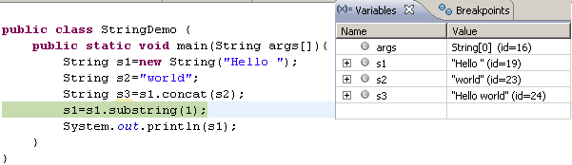
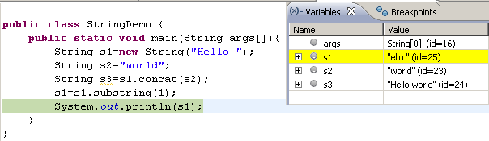
String (Contd..)

Slide 77
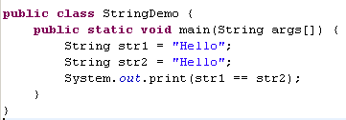
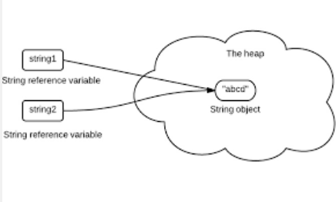
String Literal Pool
To cut down the number of String objects created in the JVM, the String class keeps a pool of strings
Each time your code creates a string literal, the JVM checks the string literal pool first. If the string already exists in the pool, a reference to the pooled instance is returned.
If the string does not exist in the pool, a new String object is instantiated, and is placed in the pool
String pool values are garbage collected when there is no live reference present for any string.
Prior to Java 7, String pool used to reside in Permgen space. After Java 7, it is moved to Java Heap.

Slide 78

Why String is Immutable in Java
String objects/literals are immutable in java
String class is marked as final.
As String are stored in cached String pool and shared among multiple clients, there is always a risk, where one client’s actions would affect all another clients.
Example- Say one client (thread) changed the value of string “Test” to “TEST”. Now all other clients or threads will start to see it as “TEST”.
Strings are very popular for HashMap key, it’s important for them to be immutable so that they can retrieve the value object which was stored in HashMap.
Strings are also used for class loading. If they were not immutable, a request to load “java.io.writer” could have been changed to “mil.vogoon.DiskEraserWriter”.

Slide 79
Best Practices for Working with Strings
If you need to concatenate a large number of strings, appending to a StringBuilder/StringBuffer object is more efficient.
StringBuilder/StringBuffer objects are like String objects, except that they can be modified. Internally, these objects are treated like variable-length arrays that contain a sequence of characters.
At any point, the length and content of the sequence can be changed through method invocations.
StringBuilder (since JDK 1.5) should be used when there is no concern of thread safety.
StringBuffer should be used for the pieces of code involving multi-threaded access

Slide 80
Exercise – MessageReader
Create a program to read some messages from user.
The user can enter any number of sentences.
When the user enters “END”. All the sentences the user entered should be displayed.
Hint: Use StringBuilder or StringBuffer to complete the program.

Slide 81
Exception Handling
11

Slide 82
What are Exceptions in Java ?
This is the feature provided in Java to handle the failure conditions gracefully.
Exception is a class which extends Throwable.
Objects of Exception can be thrown and caught.
Object
Throwable
Exception

Slide 83

Need for Exception Handling
Things can go wrong at run time. For ex. code that assumes the file to be in a given directory but file missing.
Second Example – Getting an element from an ArrayList at the nth index which is not present.
The code should gracefully handle these situations
Exception handling along with logging is a very important tool for debugging purposes.

Slide 84

Try-catch
The risky logic needs to be written in try block.
Catch block is an exception handler.
Compiler is relaxed that the exception has been handled.
At runtime, program does not stop execution.

Slide 85

Flow of Control in try-catch
There are two possibilities in third party risky methods.
Method succeeds without failure
In this case, there is no issue and no role of try-catch block.
Method fails
Control directly come to the catch block, no line of code below the line that threw the exception is executed.

Slide 86

Exercise
Write a java program to calculate the principal using the formula
principal = interest*100/(time*rate)
Accept interest amount, time and rate as input parameters. Check for the limiting cases when rate is zero or time is zero. Handle exception appropriately.
Demonstrate “CalculatePrincipalTest” class.

Slide 87

Exception Hierarchy
An exception is an object of type Exception.
Throwable is the super class of Exception. Error and Exception are subclasses of Throwable.
Errors are fatal problems like out of memory errors. These are not supposed to be handled. Application stops execution under Error.
A method can throw an exception if something goes wrong at runtime.

Slide 88


Throwing Exceptions
If a method does not know how to handle the exception, it can throw the exception to its calling method.
Java provides two key words to throw exceptions:
throws – used to advertise that the method might throw some exceptions.
throw – used to throw exception from method definition.
A method can throw multiple
exceptions.

Slide 89

Catching Exceptions
Catch all the exceptions thrown inside the try block.
Ordering of catch blocks is important.
Specific exceptions should be caught first.
Generic exceptions should come later.
Compiler forces this ordering
Exceptions are polymorphic.
Super class exception can catch all subclass exceptions.

Slide 90

Exercise
Write a program to calculate the square root of a number. It takes an integer as input and then check whether input is negative or not.
If negative, the method throw ArithmeticException with message that “Square root of negative number is not supported.” Call this method from main and handle the exception.
Demonstrate “SquareRootTest” class.

Slide 91

Finally
finally block always executed whether exception occurred or not.
Scarce and costly resources
Data base connection, File opening operation etc. should always be closed or released even if application throws exception.
Method call fails
Exception is caught
Finally block is executed.
Method call succeeds
Finally block is executed.

Slide 92

Exercise
Write a program to bake a pizza in oven. The bake method throws the exception if it is not able to bake the pizza appropriately in less than 5 minutes.
The oven needs to be turned off irrespective of whether the pizza is baked completely or the method threw an exception.
Demonstrate “BakePizzaTest” class.

Slide 93

Exception Types
There are two types of exceptions
Checked
Unchecked
See adjoining diagram for exceptions falling in checked and unchecked categories.
The compiler forces you to either catch checked exceptions or throw them to the calling method. For ex. IOException.

Slide 94

Exception Types (Contd..)
Unchecked exceptions are due to programming bugs (for ex. index out of bound exception).
The compiler expects you to handle this in the code so it does not force you to catch unchecked exceptions.

Slide 95

Exercise
Define an object reference and initialize it to null. Try to call a method through this reference. The system should throw NullPointerException but the compiler does not force you to catch this exception. Why?
Create a reference of the Object class and call its “wait” method. Is your code compiling? Enclose the code in try-catch block.
Demonstrate “ExceptionTypeTest” class.

Slide 96

Exercise
Do not catch all exceptions in a single catch block like below. Catch each exception separately and write handler for each one. Following is not recommended.
A user friendly message along with the values that can help in debugging should be logged or thrown when an exception occurs.
try {
//your code here
}
catch (Exception e) {
}

Slide 97

Questions
Can a catch or finally block exist without try block?
Is it mandatory for a try block to be followed by a catch or finally block?
Will the finally block run if there is a return statement from try or catch block?

Slide 98

Let us revise
Throwable is the base class of both Exception and Error.
Exceptions are introduced in Java to handle the situations which can go wrong at run time.
Errors are fatal problems. These are generally not handled.
The risky logic, which can throw exception, is written in the try block.
finally block is always executed.
Exceptions are polymorphic.
Exceptions are of two types - Checked and Unchecked.

Slide 99
Quiz
Does it matter the order in which we catch the exceptions?
Yes. The specific exceptions should come before generic.
What will happen if the generic exception is caught before the specific exception?
The code will not compile.
Is it possible to write just try-finally block?
Yes.
The method signature uses ‘throw’ keyword to throw the exceptions to the calling method.
No. It uses ‘throws’.
The compiler forces the programmer to catch unchecked exceptions.
No. This is for checked exceptions.
All the exceptions that extend IOException are unchecked?
No. Exceptions extending RuntimeException are unchecked.

Slide 100
Java Serialization
12

Slide 101

Serialization
If you want to send your object outside the jvm, for example storing the object of file, storing the object in database, send object over network etc., you have to tell JVM that the object is eligible for serialization.
java.lang.Serializable is a marker interface (No method). If your class is serializable, object of your class can be sent outside the JVM and you can re-store your object from outside the JVM.
JVM
Emp

Slide 102

Working with ObjectOutputStream and ObjectInputStream
The magic of basic serialization happens with just two methods:
one to serialize objects and write them to a stream
second to read the stream and deserialize objects.
Look at the code in next slide, key points are:
Declare class (Cat here) implements Serializable interface.
We made a new cat object, which as we know is serializable.
We serialize the Cat object c by invoking the writeObject() method.
We de-serialize the Cat object by invoking the readObject() method.
Enclosing the code with try/catch and finally closing the streams.

Slide 103

Look at the code below

Slide 104
What is serialized
Default implementation of Serialization supports serialization of object state.
Default serialization doesn’t serialize some variable. These are
Serialization ignores static fields, because they are not part of any particular state.
Base class fields are only handled if the base class itself is serializable.
Transient fields.

Slide 105

How to serialize
Process of persisting the state of an object to a byte stream
Object can be persisted to a file
Object can be sent across the network
All persistable object should implement Serializable interface
ObjectOutputStream and ObjectInputStream is used

Slide 106

How to de-serialize

Slide 107


Object Graphs
If the instance variables are all primitive types, it's pretty straightforward.
what about the object that the reference refers to?
Dog contains Collar object. Now what if Dog is serializable but not Collar?
Will throw NotSerializableException: Collar
To Fix it make Collar too Serializable.

Slide 108

But ..
What if you don’t have Collar source code and it is marked as Final
Collar class itself might be refer to another non-serializable objects
So then.. What if you want to save Dog?
That's where the transient modifier comes in.
Mark Dog’s Collar transient, then serializable will simply skip the Collar during Serialization.

Slide 109

Using writeObject and readObject
When Dog with transient Collar is serialized, and when the Dog is deserialized, it comes back with a null Collar.
We want a new Collar that matches the one Dog had when the Dog was saved?
Special mechanism – Callback methods.
a set of private methods you can implement in your class
will be invoked automatically during serialization and deserialization.
These methods let you step into the middle of serialization and deserialization.

Slide 110

Inheritance and Serialization.
If a superclass is Serializable, then according to normal Java interface rules, all subclasses of that class automatically implement Serializable implicitly.
what happens if a superclass is not marked Serializable, but the subclass is?
Will work, but with some implications-
When an instance of a serializable class is deserialized, the constructor does not run.
the instance variables from the Dog's class will be serialized and deserialized correctly, but the inherited variables from the non-serializable Animal superclass will come back with their default/initially assigned values rather than the values they had at the time of serialization.
This is because the non-serializable class constructor WILL run!
In fact, every constructor ABOVE the first non-serializable class constructor will also run.

Slide 111
SerialVersion UID in Java Serialization
serialVersionUID is used to ensure that during deserialization the same class (that was used during serialize process) is loaded.
private static final long serialVersionUID = 1L;
You can assign any value to serialVersionUID.
If you do not add serialVersionUID in your source program file, serialization runtime will generate a serialVersionUID and associate it with the class.
The serialized object will contain this serialVersionUID along with other data (meta-data) or say header. It’s not serialized with the class as it is static field.
It is advised to have serialVersionUID as unique as possible.

Slide 112
How Serial Version UID Works
When an object is serialized, the serialVersionUID is serialized along with the other contents.
Later when that is deserialized, the serialVersionUID from the deserialized object is extracted and compared with the serialVersionUID of the loaded class.
If the numbers do not match then, InvalidClassException is thrown.
If the loaded class is not having a serialVersionUID declared, then it is automatically generated using the same algorithm as before.
serialVersionUID should be maintained. As and when you change anything in the class, you should upgrade the serailVersionUID.
Try your best to declare a unique serialVersionUID.

Slide 113



SerialVersion UID Demo
Class with serialVersionUID as 1-

Slide 114

Serial Version UID Demo (Contd..)
Now change serialVersionUID to 2L in Lion class.
Comment the “serialize” block (4 lines of code) in SerialVersionUIDTest. Now run it and you will get the following exception.
Basically comment the serialize part in SerialVersionUIDTest class and execute the program. Below is the exception you see.

Slide 115
Exercise
Create a class Employee with following fields
Name-string
Age-int
Sex- String
Create an instance of this Object and populate dummy data.
Persist this Object in a file name employeedata.txt

Slide 116
Exercise
Referring to previous exercise, write a program to read the employee data from employeedata.txt file and print its details

Slide 117

Assignment
How can we serialize static object? Write down a program to store static variables.
Hint: Externalizable Interface

Slide 118
Inner Classes
13

Slide 119
Inner Class Introduction
An inner class is a class that is defined inside another class. Why would you want to do that? There are three reasons:
Inner class methods can access the data from the scope in which they are defined—including data that would otherwise be private.
Inner classes can be hidden from other classes in the same package.
Anonymous inner classes are handy when you want to define callbacks without writing a lot of code.

Slide 120


Inner Class Example

Slide 121


Reference Problem
PROBLEM: We want to check the health of employee (employee is a person). checkHealth() method of Person class accept a HealthCheckup parameter. Different implementation of HealthCheckup interface can define different way of health check. Solve the problem by having a checkup method in the Employee class.

Slide 122

Solution with private inner class

Slide 123

Solution with local inner class

Slide 124
Local Inner Class
If you find that an inner class is required in a method call only, you can define that class in the method itself.
Local classes are never declared with an access specifier (that is, public or private).
Their scope is always restricted to the block in which they are declared.
Local classes have a great advantage: they are completely hidden from the outside world—not even other code in the _04Employee class (see previous slide) can access them.
Local inner class can access final local variables. Non final local variables can not be accessed by the inner class. WHY??

Slide 125

Solution with anonymous inner class

Slide 126
Anonymous Inner Class
When using local inner classes, you can often go a step further. If you want to make only a single object of this class, you don’t even need to give the class a name.
Such a class is called an anonymous inner class.
An anonymous inner class cannot have constructors because the name of a constructor must be the same as the name of a class, and the class has no name.
In particular, whenever an inner class implements an interface, it cannot have any construction parameters. Nevertheless, you must supply a set of parentheses as in
new InterfaceType()
{
methods and data
}

Slide 127
Exercise
Pair is a class having 2 integer values.
PairOperationInterface is an interface having a method
Pair executeOperation();
PairOperation is an abstract class having a method
public Pair operte(PairOperationInterface obj){
return obj.executeOperation();
}
Create a class which extends PairOperation and have an array of integer.
You need to add a method which returns a pair of minimum and maximum using inner class concept.

Slide 128
Static Inner Class
Occasionally, you want to use an inner class simply to hide one class inside another, but you don’t need the inner class to have a reference to the outer class object.
You can suppress the generation of that reference by declaring the inner class static.
Let us suppose, Health Result of an employee is to be published. Health result includes the health status after checkup and number of checkup done.

Slide 129

Solution with Static Inner Class
Static Inner Class
Method returning Static Inner Class
Create object of static inner class

Slide 130

Client Code
Reference of static inner class

Slide 131
Exercise
Pair is a class having 2 integer values.
PairOperationInterface is an interface having a method
Pair executeOperation();
PairOperation is an abstract class having a method
public Pair operte(PairOperationInterface obj){
return obj.executeOperation();
}
Create a class which extends PairOperation and have an array of object.
You need to add a method which returns a pair of minimum and maximum using inner class concept.
Create Pair as a static inner class.

Slide 132
Recap
Static keyword- variables, methods, block of code, static inner class, interface static method.
Static variables and methods belongs to class and not to objects.
Static methods/variables can be accessed directly by class name.
Static variables/blocks are initialized/executed the very first time the class is loaded.
Static inner classes are like normal classes except that they are enclosed inside another class.
Interface too can have static methods (introduced in java 8) and can’t be override.
Final keyword- variable, method and classes
When used with variable, makes them constant.
Static methods and classes can’t be overridden.
Used in context of making immutable objects.

Slide 133
Recap
Object Initialization
Chunk of memory allocated in heap.
new operator or newInstance() method of class Class is used to create new objects.
Instance variables are initialized with default values if none specified at the time of object creation.
Constructors are used to initialized values to objects.
When a subclass’s constructor is called, it will automatically call the superclass’s constructor and this chain keeps on until the super most class’s constructor is called.
Hash Code and equal methods contract
Present in Object class.
Should be override in context of collection. If your object is to be stored in Collection like hashmap.
Contract says-
If two objects are equal, then they must have same hash code.
If two objects have the same hash code, they may or may not be equal.

Slide 134
Recap
Overriding Rules- Certain rules which must be taken care
The argument list must exactly match that of the overridden method.
The return type must be the same as, or a subtype of, the return type declared in the original overridden method in the superclass.
The access level can't be more restrictive than the overridden method's.
Ex.- public to protected is not allowed.
The access level CAN be less restrictive than that of the overridden method.
The overriding method CAN throw any unchecked (runtime) exception, regardless of whether the overridden method declares the exception.
The overriding method must NOT throw checked exceptions that are new or broader than those declared by the overridden method.
The overriding method can throw narrower or fewer exceptions.
Instance methods can be overridden only if they are inherited by the subclass. Methods from super class that are not marked private or final.
You cannot override a method marked final and static.

Slide 135
Recap
Immutability
Objects whose state can’t be changed.
Used heavily in multi-threading.
String class is immutable.
Revise the immutable rules- ?
Java Cloning
Used to create duplicate objects at run time.
Two types
Shallow Cloning-
You only need to implement the cloneable interface and java itself will take care.
Deep Cloning- when object contains references to other objects, you need to override the clone() method.
Note: The protected clone() method is present in Object class. But your class must implement the Cloneable interface to get cloned. This is bit confusing, but it is this way only.

Slide 136
Recap
Annotations – Meta Data
Declarative style of programming.
Several pre built annotations-
@override, @deprecated, @suppresswarning etc.
User defined (Custom) annotations-
@interface keyword is used to create new annotation.
@Retention annotation is used to define retention policy-
Source, class or runtime.
@Target annotation defines the set of elements where it can be applied like methods and constructors
String pool
String is an immutable object.
Interned string or string literal lies into string pool. (for performance and security reasons)
When a string is modified, a new string object is created instead of modifying the existing object.
Prior to java 7, string pool resided in Permgen space, and java 7 onwards it is moved to Java Heap.
Use StringBuilder when there is no concern of thread safety. Use StringBuffer in case of multi threaded.

Slide 137
Recap
Exception Handling
Handle failure conditions gracefully.
Exception is a class which extends Throwable.
Objects of Exception can be thrown and caught.
Try-catch block.
Finally block is always executed.
Types
Checked
Compile give error if not handled.
Unchecked
Compiler let pass and don’t give error if not handled.

Slide 138
Recap
Serialization
Saving the object’s state is called serialization.
Reading the serialized state back into object is called deserialization.
ObjectInputStream/ObjectOutputStream are used to read/write objects.
Static and transient variables are not serialized.
If super class is serializable then sub classes are automatically serializable.
If super class is not serializable and subclass is serializable, then non-serializable super constructor will run and non-serializable part of object is initialized to initial values.
serialVersionUid is used for version controlling.
If serialVersionUID is not provided, then JVM provides default serialVersionUID.

Slide 139
Recap
Inner Classes
A class inside another class is called inner class.
Inner class can be used when you have different functionality but somewhat related. Example- Listener classes.
Types
Local Inner Class
Regular inner classes
Anonymous Inner Class
Without name. Created just right at the moment when required.
Static inner class
Regular inner classes with static keyword.

